Slide 1
Graphs, Spreadsheets, Dependence

Slide 2
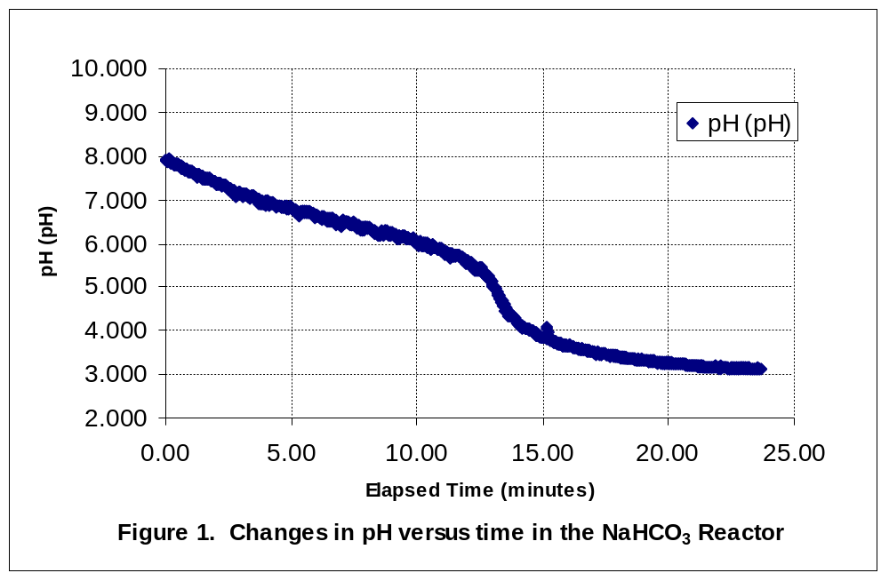
Make this Graph Better…

Slide 3
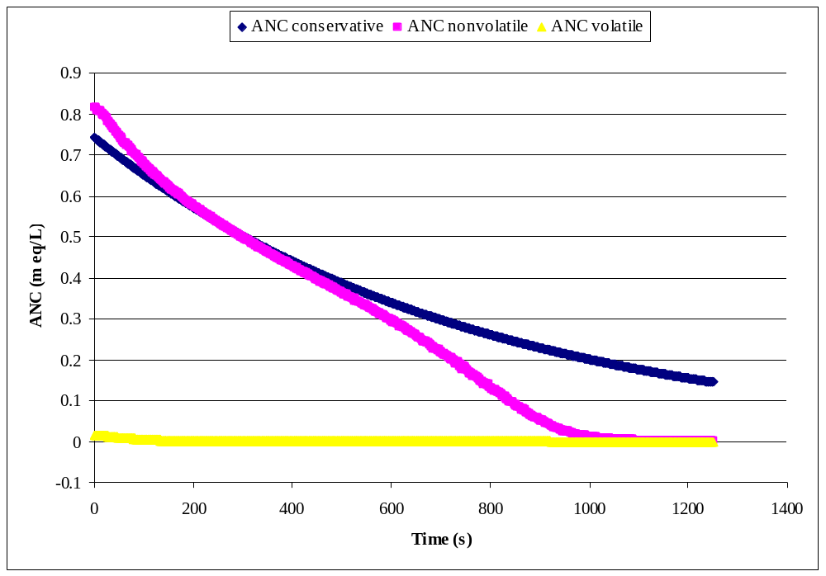
Make this Graph Better…

Slide 4
If you use lines to plot data what else do you need?
Specify the data interval!

Slide 5
Equations
=($H$1*$H$5/J11)*(K11+2*L11)+($H$2/I11)-I11
What function is this?
How could you make the spreadsheet easier to follow?

Slide 6
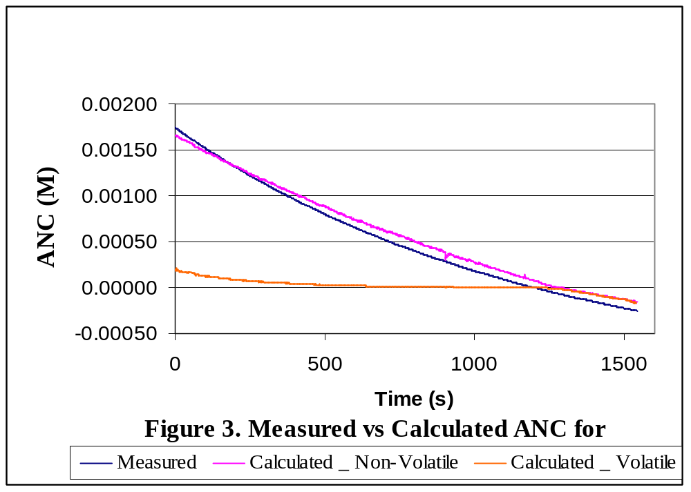
Analysis?

Slide 7
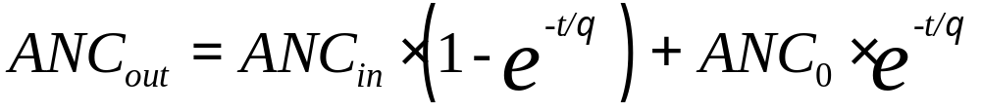
Trace Precedents

Slide 8
Dependence
The initial ANC could be entered directly into the spreadsheet or it could be calculated based on the volume of the lake and the mass of sodium bicarbonate.
Which technique is better and why?

